Slide 1
COMP 282 – Advanced Data Structures
Efficiency of Algorithms
Why Efficient Code?
Computers are faster, have larger memories
– So why worry about efficient code?
And … how do we measure efficiency?

Slide 2
Example – Sum of First n Values
Consider the problem of summing
n
Σ i = 1 + 2 + 3 + … + n
i=1
How would we code this?
Example – Sum of First n Values
Approach A
sum = 0;
for (i = 1; i <= n; i++) sum = sum + i;
Approach B
sum = 0;
for (i = 1; i <= n; i++)
for (j = 1; j <= i; j++) sum = sum + 1;
Approach C
Sum = n * (n+1) / 2

Slide 3
Sum of First n Numbers
public static void main(String[] args) { long n = 10000;
long sum = 0;
// Algorithm A
for (long i = 1; i<= n; i++) sum = sum + i;
System.out.println("Sum is " + sum);
sum = 0;
// Algorithm B
for (long i = 1; i <= n; i++) for (long j = 1; j <= i; j++)
sum = sum + 1; System.out.println("Sum is " + sum);
sum = 0;
// Algorithm C
sum = n * (n + 1) / 2; System.out.println("Sum is " + sum);
}

Slide 4
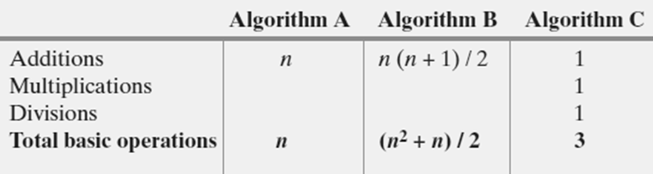
What is “best”?
An algorithm has both time and space constraints – that is complexity
Time complexity
Space complexity
This study is called analysis of algorithms
Counting Basic Operations
A basic operation of an algorithm
– The most significant contributor to its total time requirement
Number of required basic operations

Slide 5
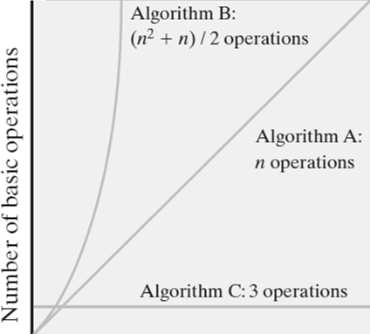
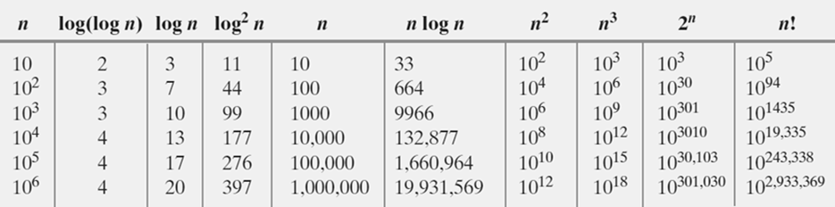
Counting Basic Operations
Number of basic operations required by the algorithm
Counting Basic Operations
Typical growth-rate functions evaluated at increasing values of n

Slide 6
Best, Worst, and Average Cases
For some algorithms, execution time depends only on size of data set
Other algorithms depend on the nature of the data itself
– Here we seek to know best case, worst case, average case
Big Oh Notation
A function f(n) is of order at most g(n)
That is, f(n) is O(g(n))—if
A positive real number c and positive integer N exist …
Such that f(n) ≤ c x g(n) for all n ≥ N
That is, c x g(n) is an upper bound on f(n) when
n is sufficiently large

Slide 7
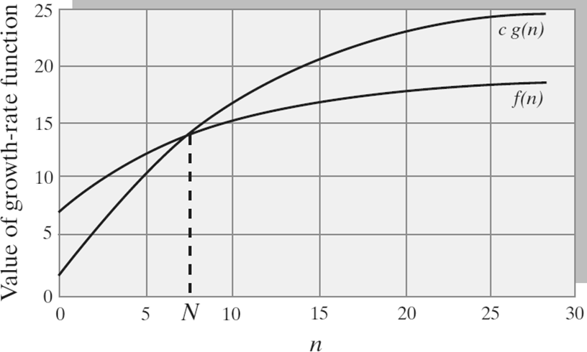
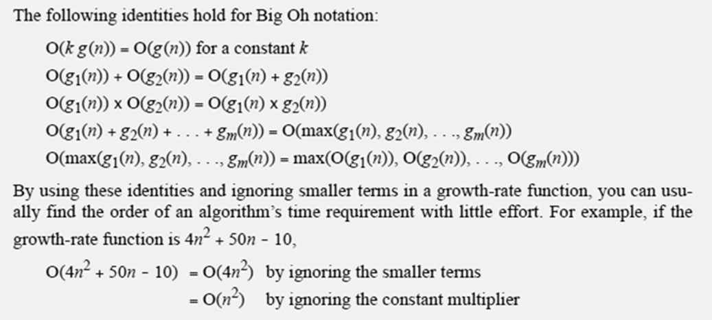
Big Oh Notation
Big Oh Notation

Slide 8
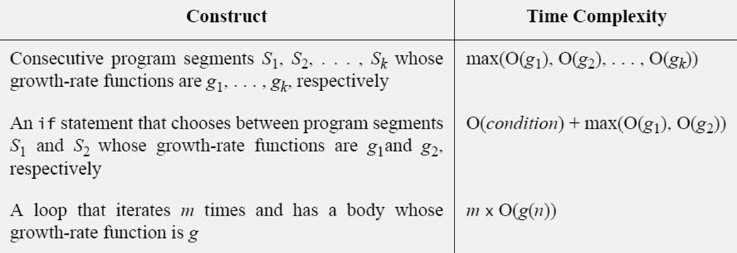
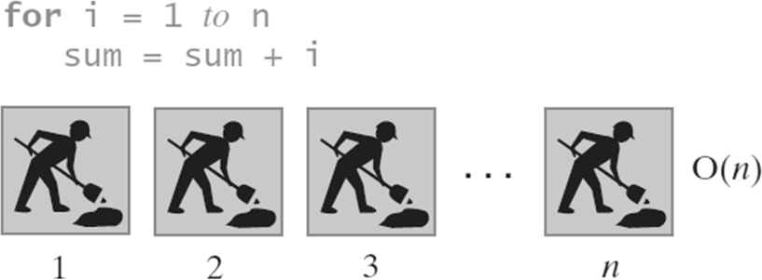
Complexities of Program Constructs
Picturing Efficiency – O(n)

Slide 9
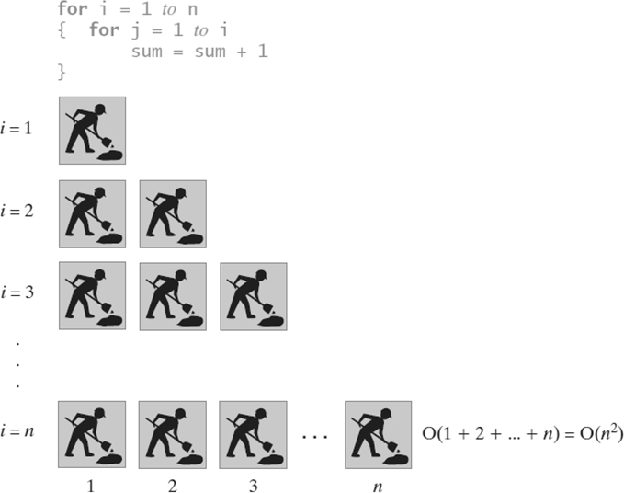
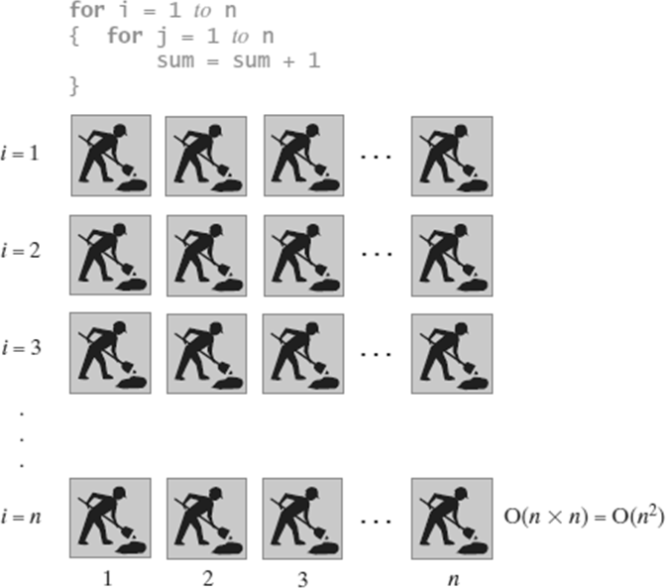
Picturing Efficiency – O(n²)
Picturing Efficiency – O(n²)

Slide 10
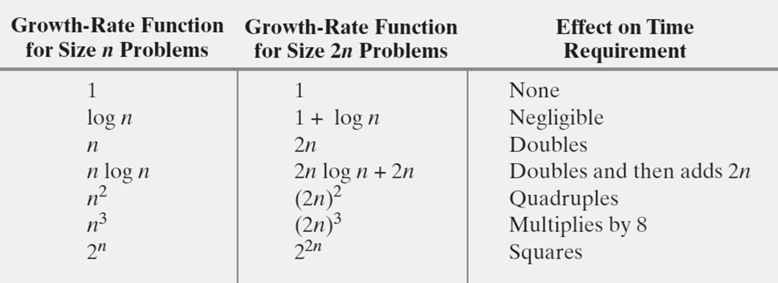
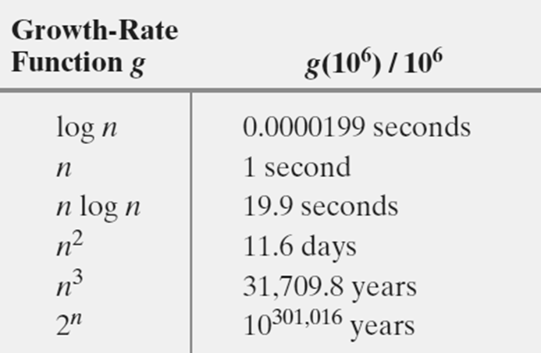
Effect of Doubling the Problem Size
Time Required To Process One Million Items
Rate is one million operations per second

Slide 11
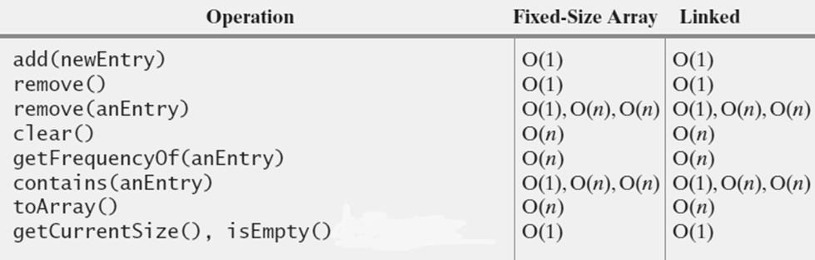
Efficiency of Implementations of ADT Bag

